Slide 1
IBM Bob Gujarat State level Hackathon Project Submission
“Exploring the Power of Agentic AI with IBM Granite and IBM Bob”

Slide 2

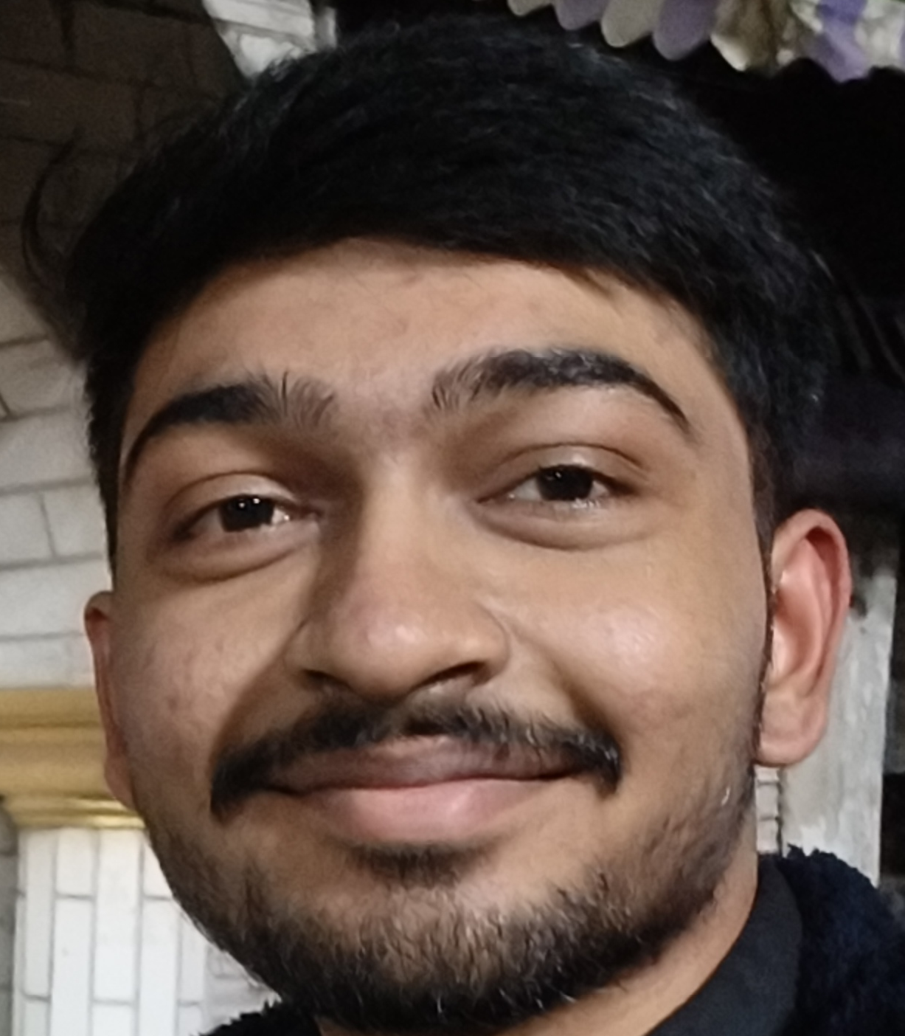
Project Tile : GreenPulse AI – Agentic Renewable Energy Intelligence Platform
Domain of Project : Energy & Sustainability
Student Name | Recent Passport Photo | Email ID | Mobile number [WhatsApp]
Yash Kayastha |  | kyt47000@gmail.com | 7201862574
Paras Bhaliya |  | parasbhaliya2@gmail.com | 7600645406

Slide 3
Problem Statement :
Smart Renewable Energy (Solar-Wind Hybrid) Asset Monitoring for Kutch & Banaskantha
Domain
Energy & Sustainability
The Challenge
Gujarat leads India in hybrid solar-wind renewable capacity, particularly in Kutch and Banaskantha, but scattered installations face inefficiencies from inconsistent maintenance scheduling, under-performance detection, and grid integration challenges.
Inconsistent Maintenance → Reactive scheduling and delayed servicing
Asset Under-performance → Difficulties in identifying anomalies and energy losses
Weather Variability → Uncertain solar and wind generation
Grid Integration → Challenges in balancing generation, storage, export and curtailment
Fragmented Data → Multiple sensors, SCADA and monitoring systems with limited unified intelligence
Target AI Agents
Asset Performance | Predictive Maintenance | Weather & Generation Forecasting | Grid Optimization | Renewable Energy Dashboard
Core Problem
How can we transform scattered renewable-energy data into proactive, AI-driven decisions that improve asset performance, reliability, and grid integration?

Slide 4
Proposed Solution :
GreenPulse AI - Agentic AI for Smarter Renewable Energy Management
GreenPulse AI is an IBM-powered platform that connects renewable-energy assets, real-time data, and autonomous AI agents to detect issues, predict generation, optimize performance, and support faster decisions.
Using IBM Granite, watsonx.ai, and IBM Cloud, multiple specialized AI agents work together to predict maintenance needs, forecast renewable generation, and optimize grid integration through data-driven recommendations.
The platform brings all insights into a single intelligent dashboard, helping operators take faster action, reduce downtime, improve energy generation, and achieve smarter and more reliable renewable-energy management.

Slide 5
Tech Stack Used :
AI / LLM
• IBM Granite 13B with IBM BOB
• IBM watsonx.ai inference API
• Multi-agent agentic architecture
• Mock AI fallback (no-key mode)
IBM Cloud
• Event Streams (Kafka 3.x)
• Databases for PostgreSQL
• Code Engine (deploy target)
• IAM API key authentication
Frontend
• React 18 + TypeScript
• Vite 5 + Recharts
• React Router v6
• useLiveStream SSE hook
• IBM Plex Sans + Mono fonts
Backend
• Node.js + Express 4
• TypeScript + ts-node
• Server-Sent Events (SSE)
• dataSourceAdapter pattern

Slide 6
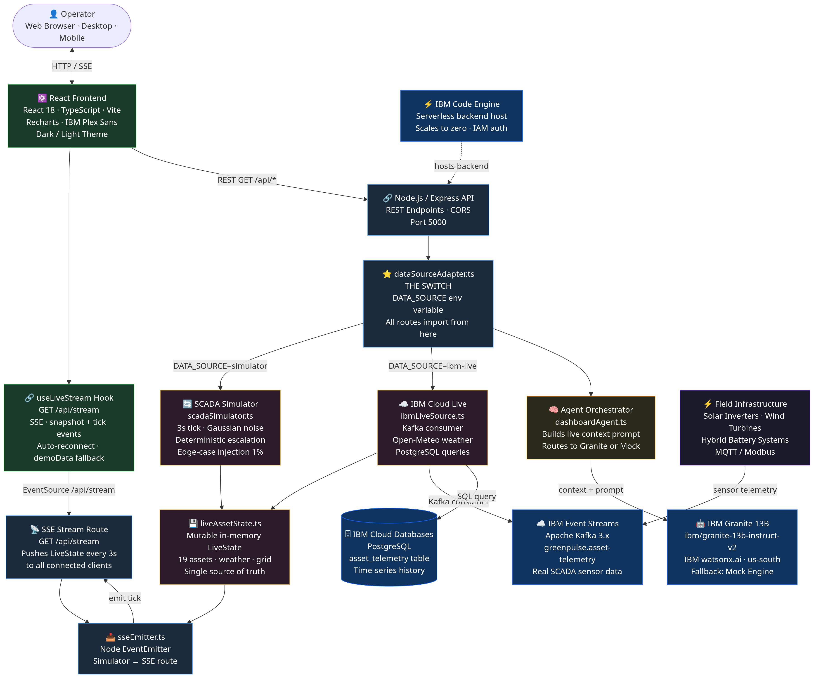
Architecture

Slide 7
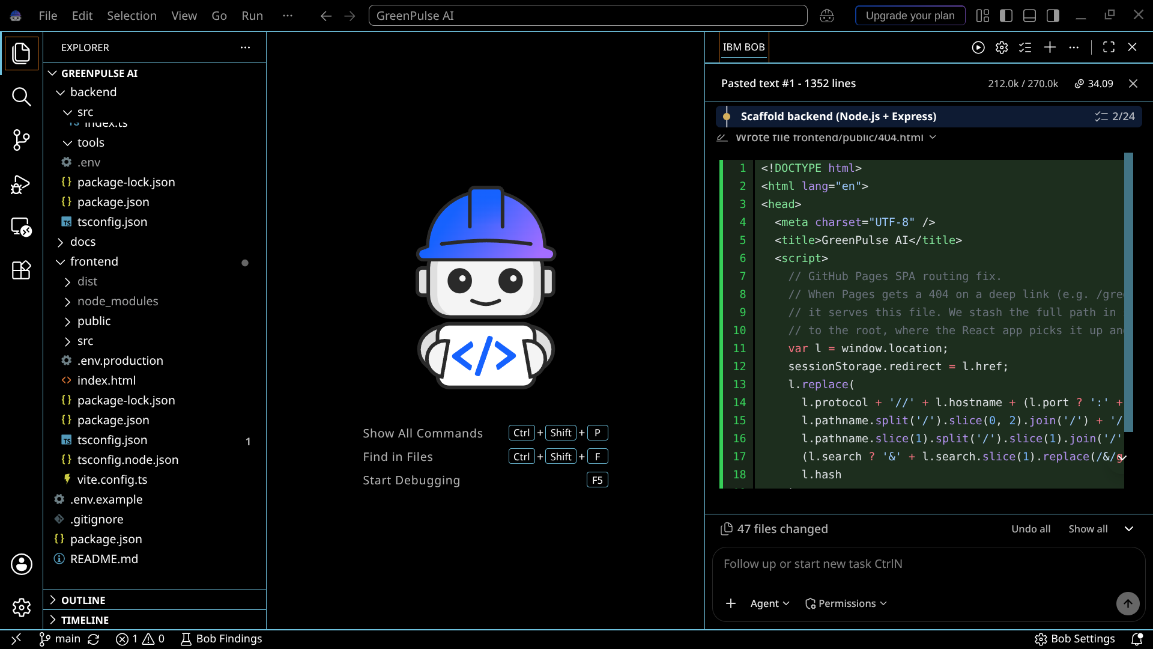
IBM Bob Screenshots:

Slide 8
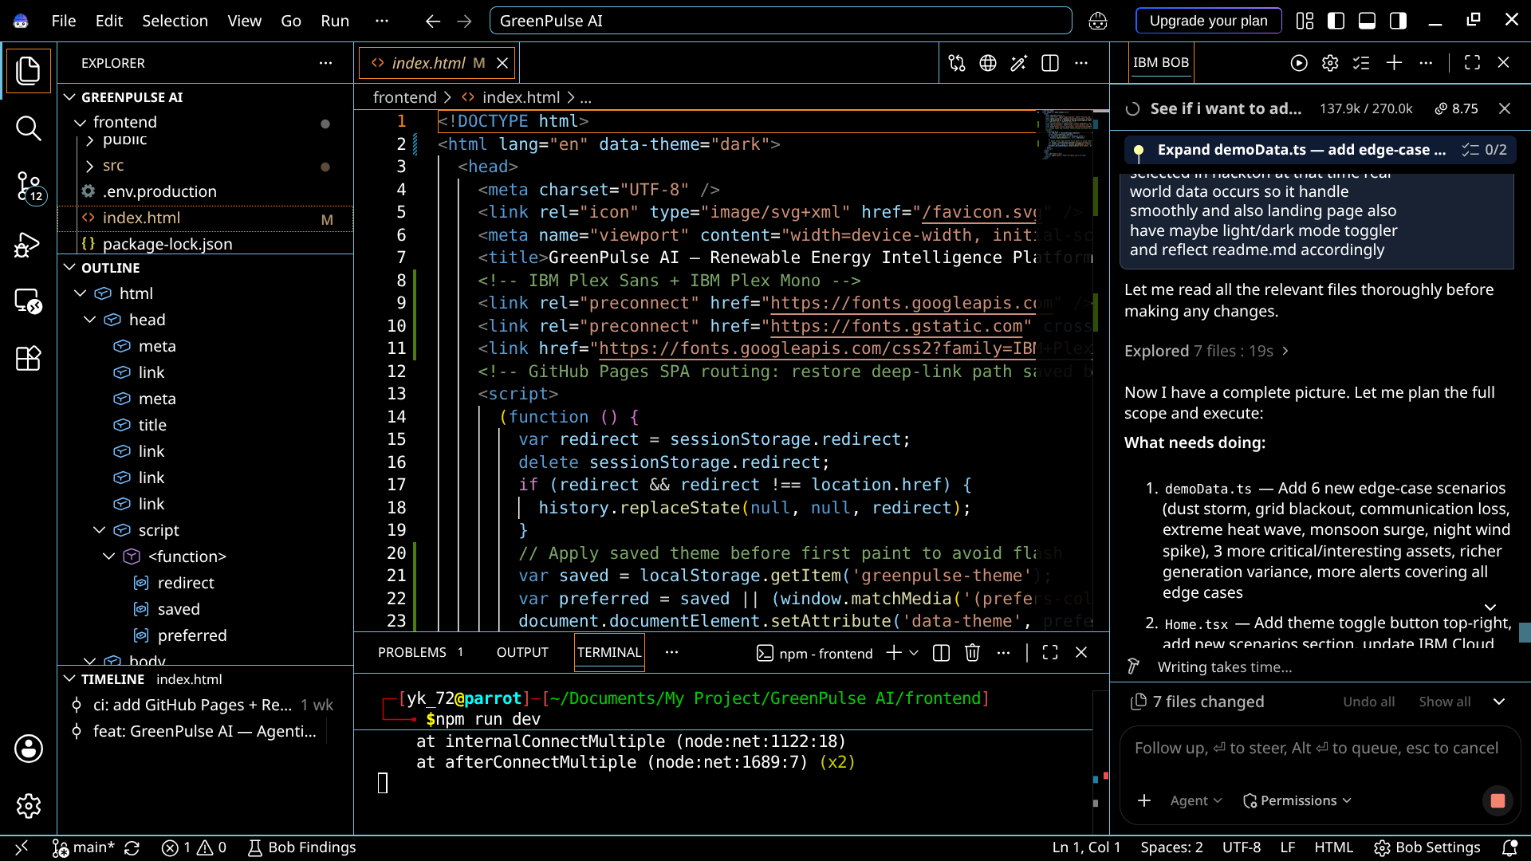
IBM Bob Screenshots:

Slide 9
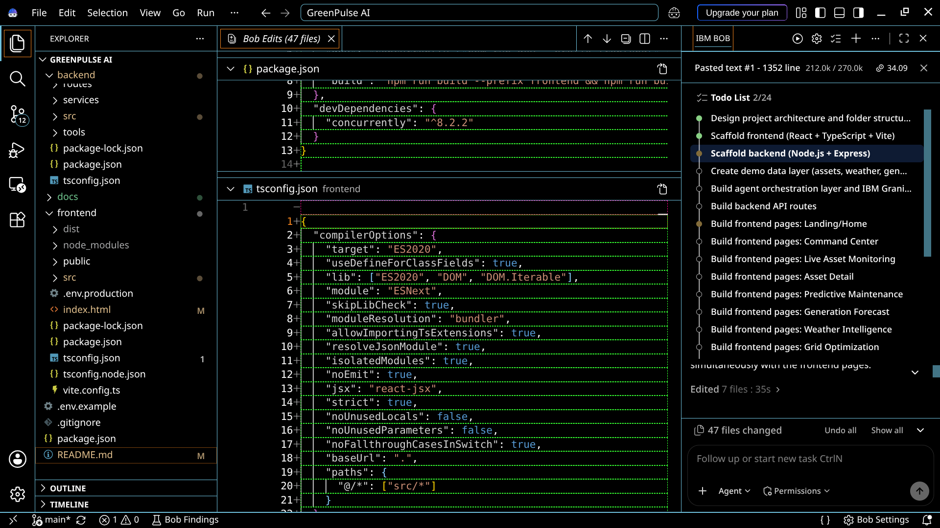
IBM Bob Screenshots:

Slide 10
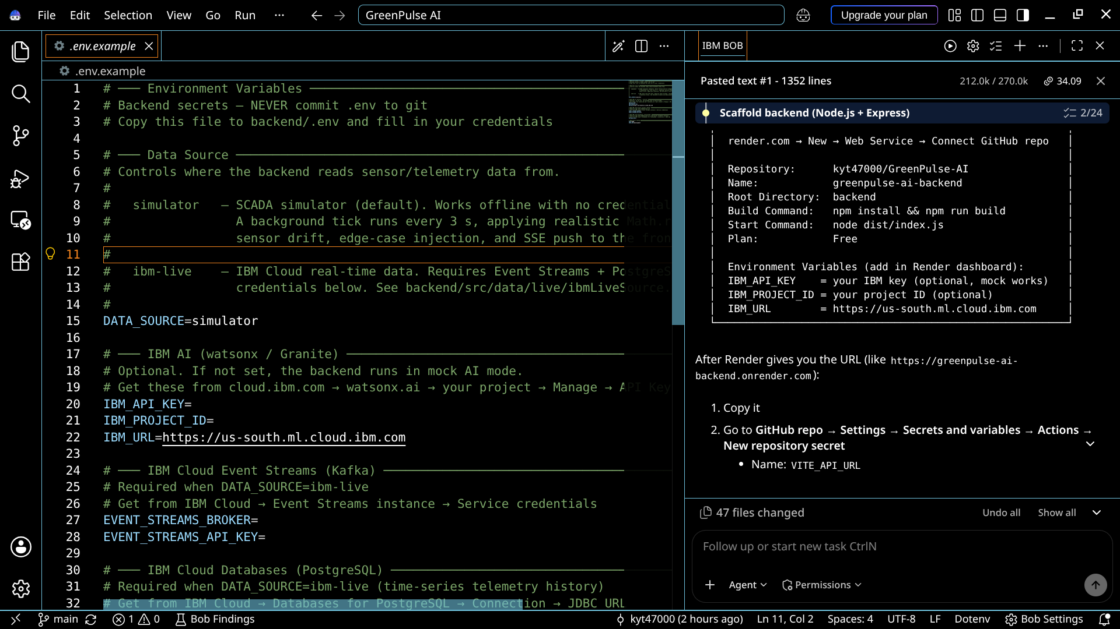
IBM Bob Screenshots:

Slide 11
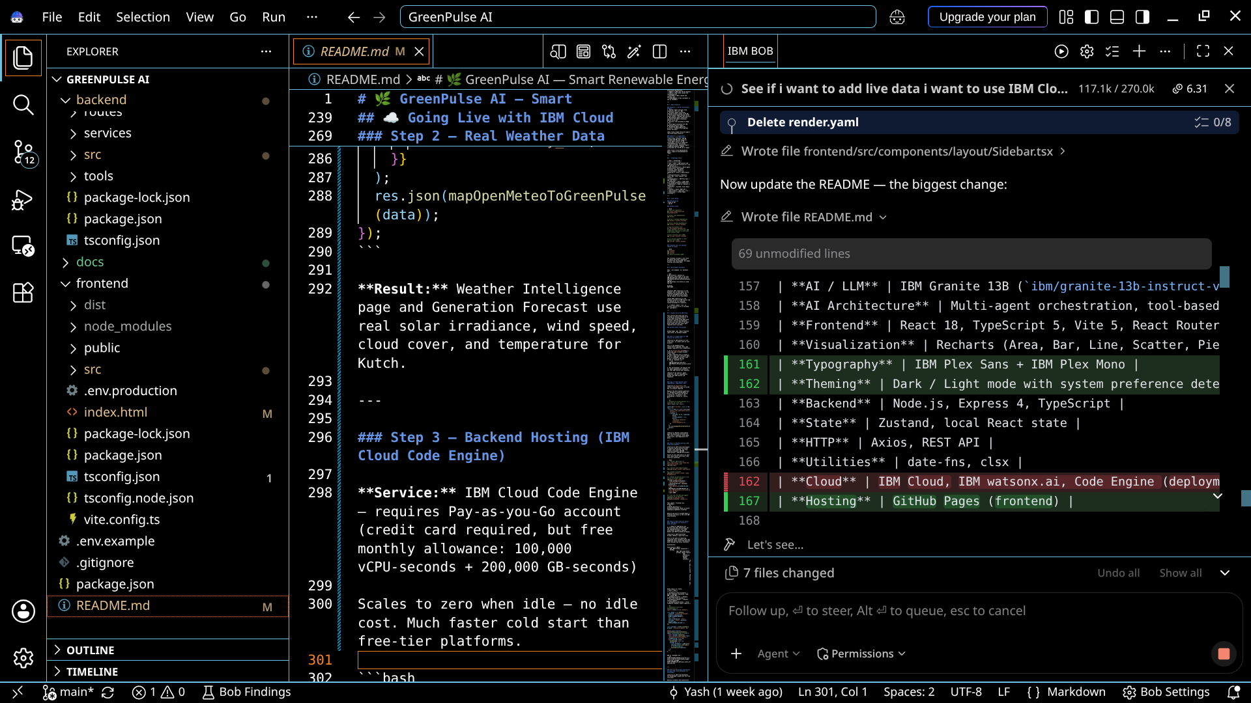
IBM Bob Screenshots:

Slide 12
Role of Agentic AI in GreenPulse AI
Powered by IBM Granite 13B LLM & IBM watsonx.ai — six specialized agents collaborate in real time to monitor, predict, and optimize 19 renewable energy assets across Kutch & Banaskantha, Gujarat.
Weather Agent
Analyzes irradiance, wind speed, dust index, extreme events
Maintenance Agent
Predicts failures from vibration, temperature & RPM trends
Key Capabilities
Real-Time Context : Agents receive live sensor data every 3 seconds; every IBM Granite response is built from the current asset state, not static data
Agent Chaining : Each agent passes its finding to the next: Weather → Forecast → Performance → Maintenance → Grid → Dashboard
Explainable Decisions : Every recommendation includes WHAT was detected, WHY (sensor readings + thresholds), ACTION (with timeframe), and CONFIDENCE %
Proactive Intelligence : Detects WT-07 gearbox degradation days before failure; forecasts grid curtailment hours ahead — not just threshold alerts
Forecast Agent
Predicts solar & wind output 48 h ahead incl. dust storms & cut-out
Grid Agent
Manages export, storage & curtailment — blackout response
Performance Agent
Detects anomalies — output deficits, SCADA comm loss, thermal derating
Dashboard Agent
Orchestrates all agents — produces AI Copilot recommendations
"Six specialized agents. One coordinated intelligence. Acting as a proactive digital operations engineer — autonomous, context-aware, and explainable."

Slide 13
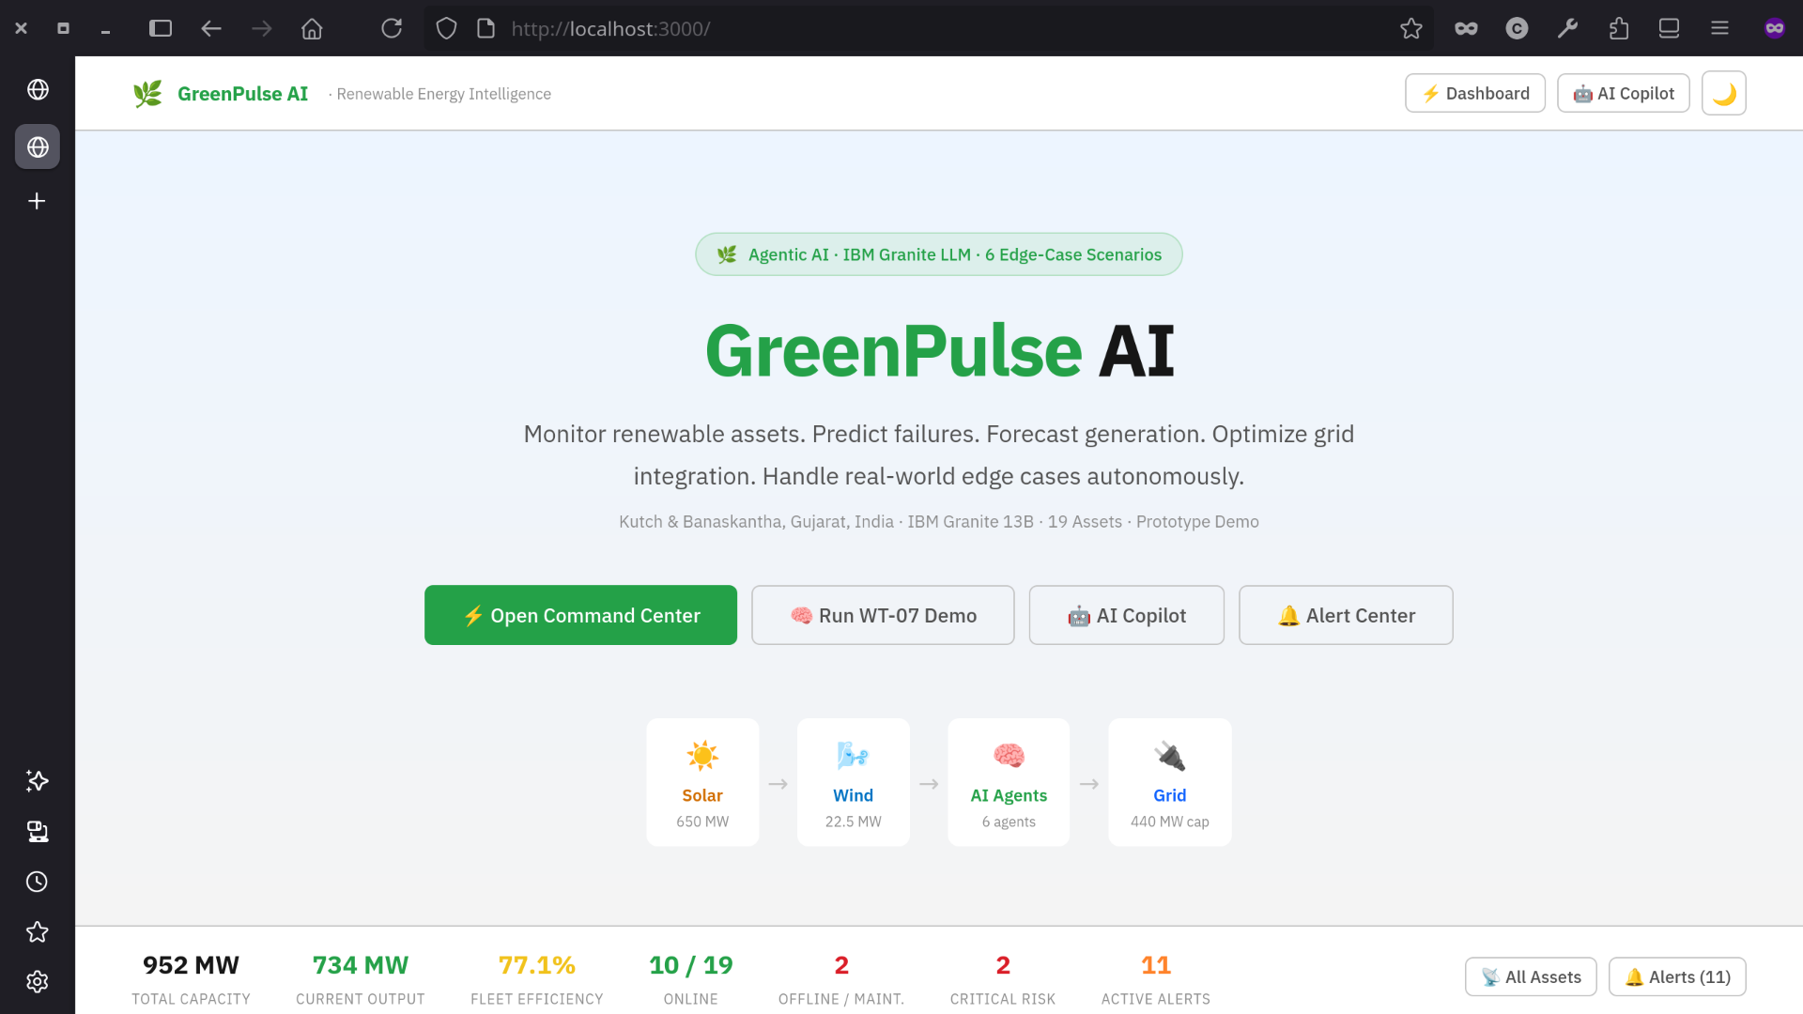
Project Output Screenshots: (Landing Page)

Slide 14
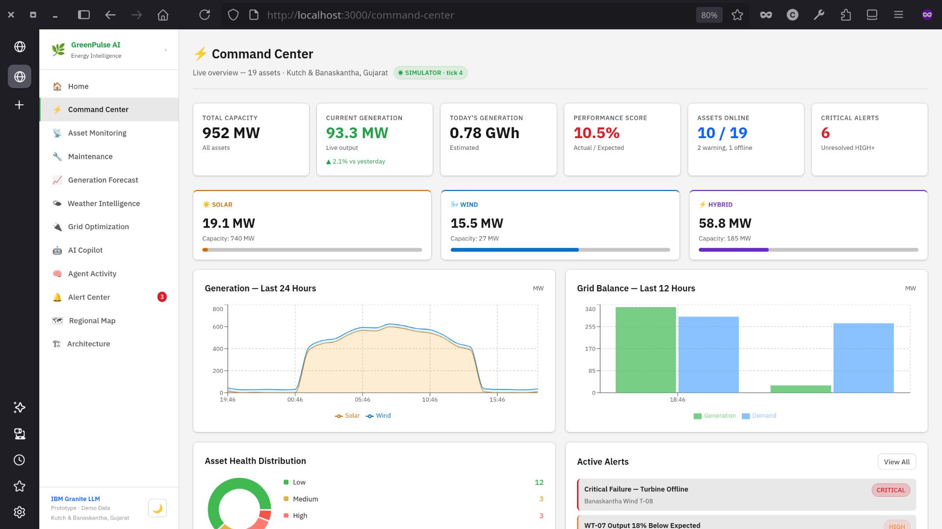
Project Output Screenshots: (Command Center)

Slide 15
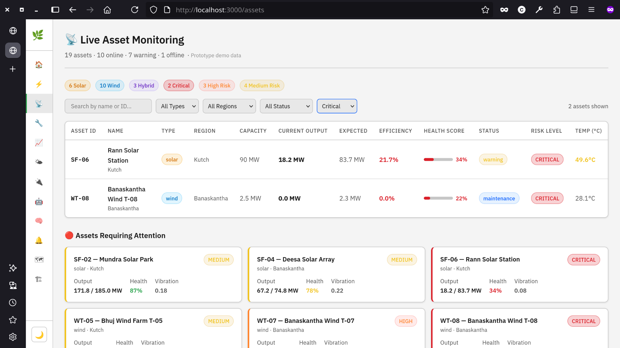
Project Output Screenshots: (Live Assets)

Slide 16
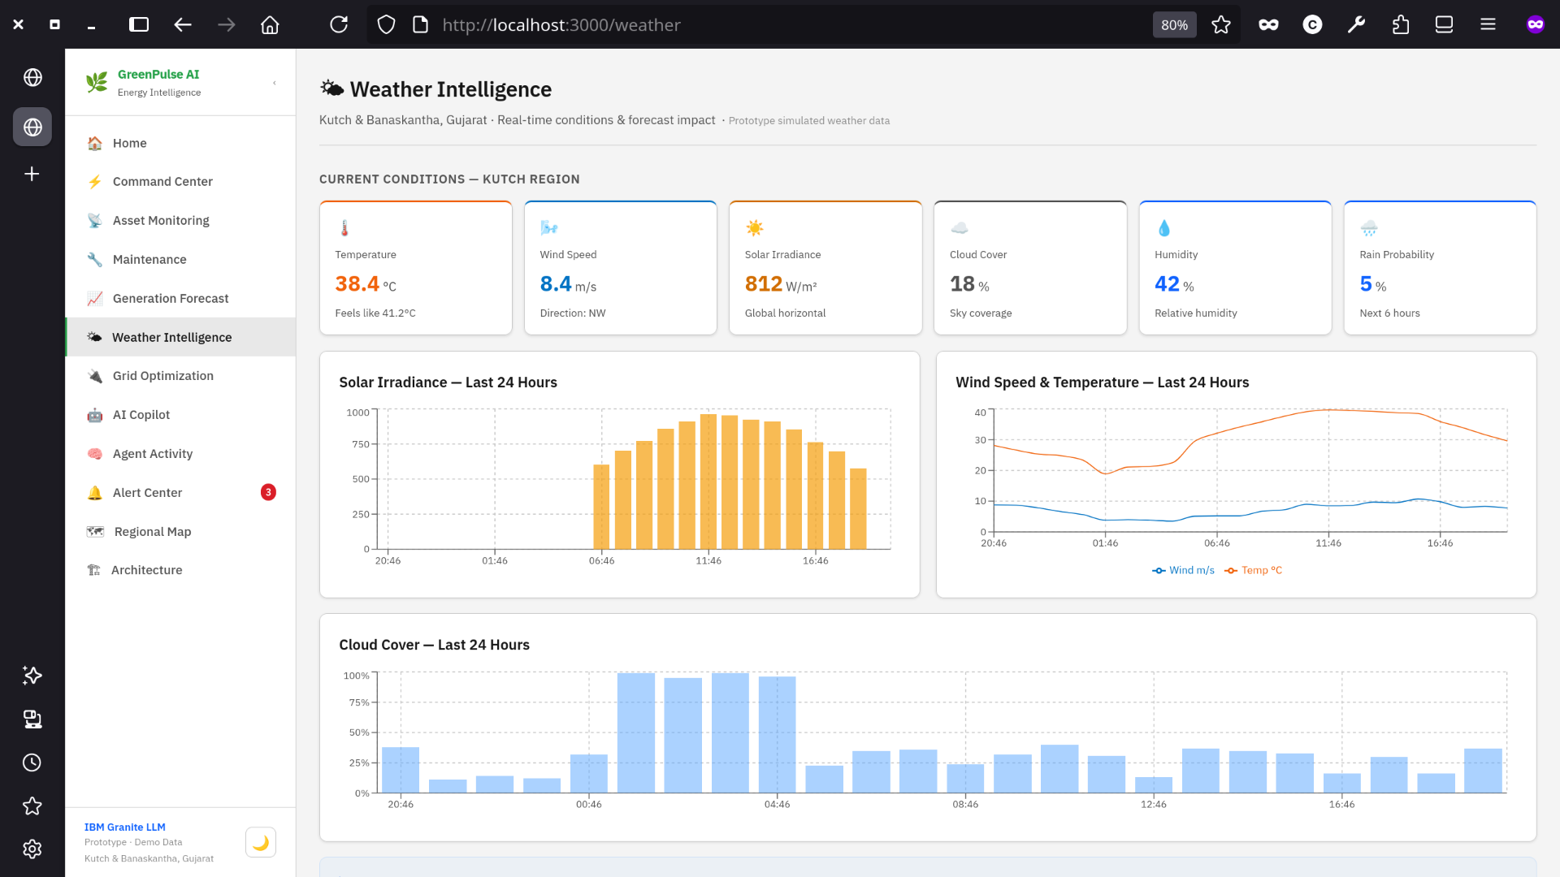
Project Output Screenshots: (Weather Intelligence)

Slide 17
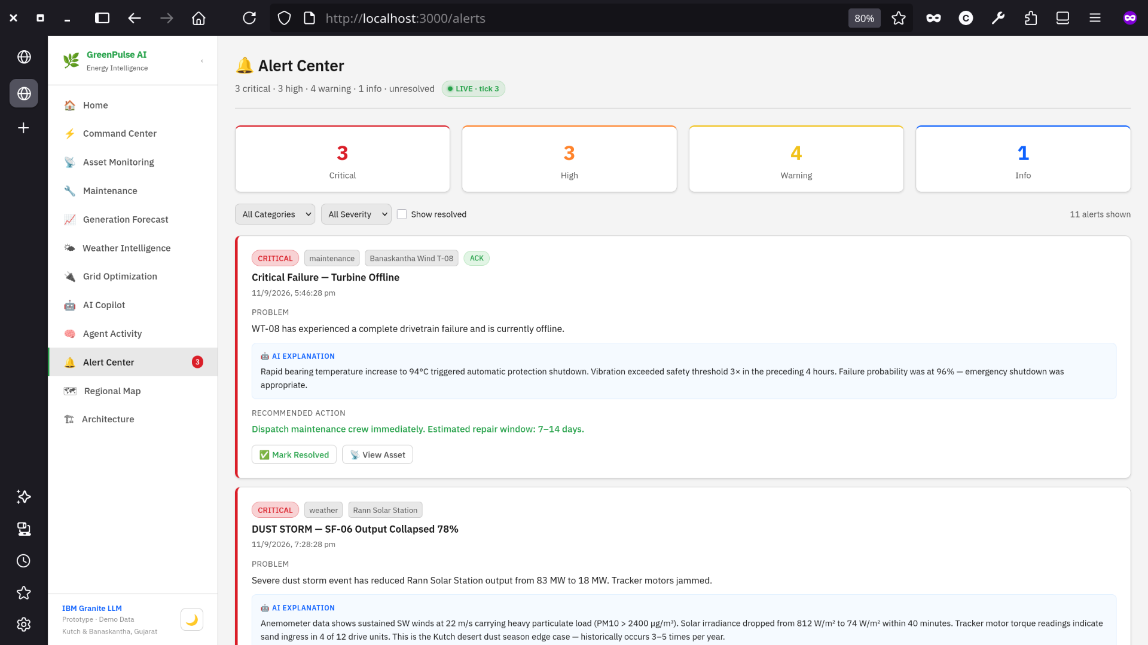
Project Output Screenshots: (Alert Center)

Slide 18
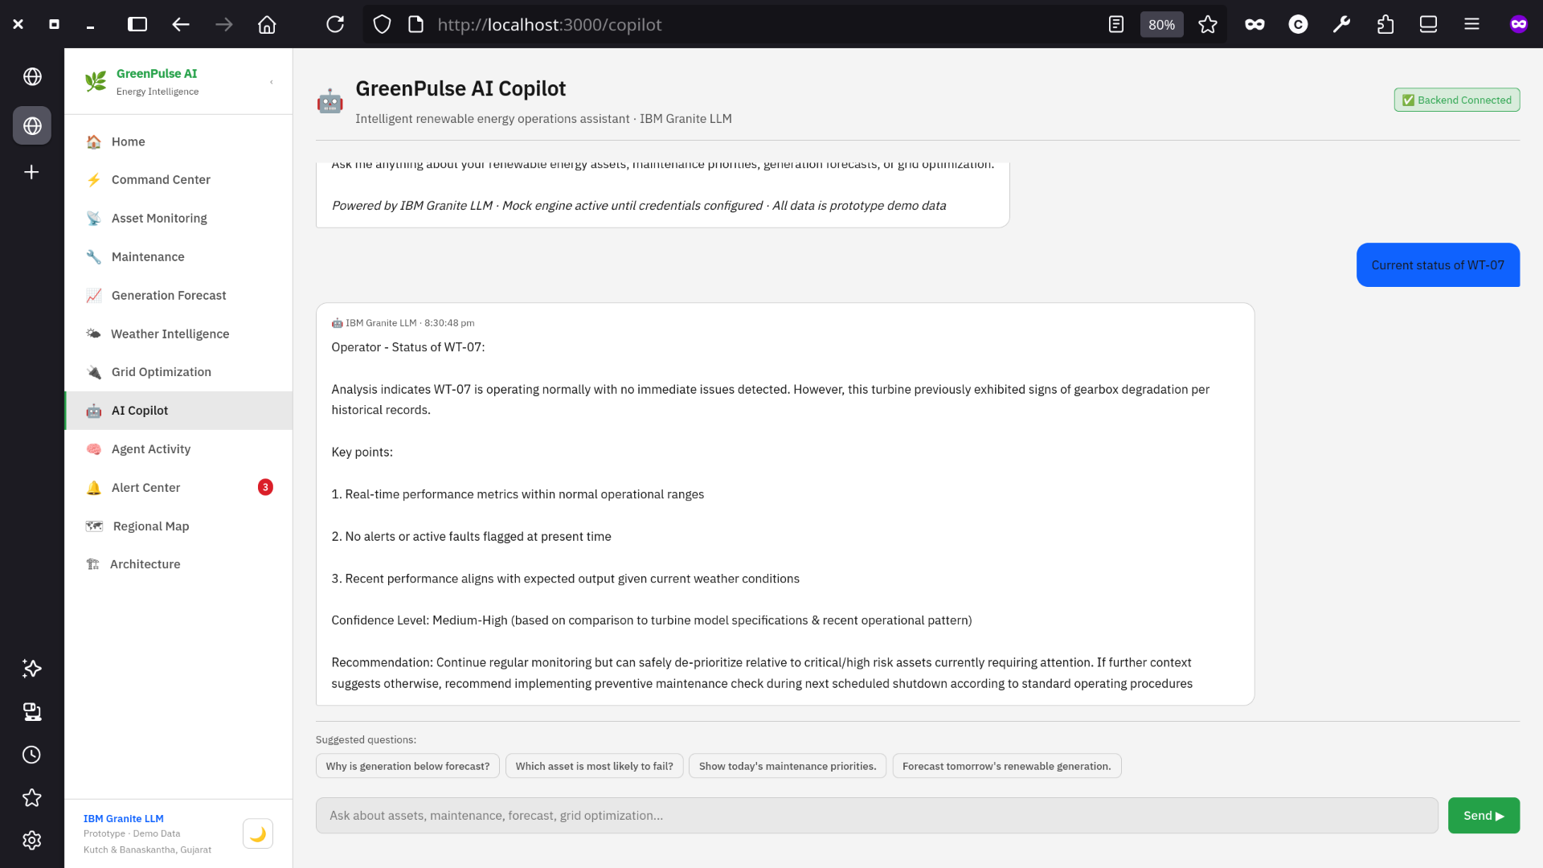
Project Output Screenshots: (AI Copliot)

Slide 19
Future Scope
From prototype to production — the roadmap for GreenPulse AI at scale across Gujarat's renewable energy grid.
IBM Cloud Event Streams (Live SCADA Data)
Replace the SCADA simulator with real-time sensor telemetry via IBM Cloud Event Streams (Apache Kafka). Each field asset — solar inverters, wind turbine controllers, hybrid battery systems — publishes readings to the greenpulse.asset-telemetry topic every few seconds. Zero frontend or route changes needed — just flip DATA_SOURCE=ibm-live in .env.
Real Weather Integration (Open-Meteo API)
Integrate live solar irradiance and wind speed data from Open-Meteo API for Kutch (lat 23.73°N, lon 69.86°E). Already stubbed in ibmLiveSource.ts — refresh every 60 seconds, feeding the Weather Agent with actual field conditions instead of simulated drift.
IBM Cloud Databases — Time-Series Storage
Persist all asset telemetry in IBM Cloud Databases for PostgreSQL. Enables historical trend analysis, long-term degradation tracking, seasonal generation patterns, and regulatory reporting. The SQL schema (asset_telemetry table) is already defined and stubbed — ready to connect.
IBM Cloud Code Engine — Production Deployment
Deploy the Node.js backend as a containerized IBM Cloud Code Engine application — serverless, scales to zero when idle, zero infrastructure management. Combined with the existing GitHub Pages frontend, this gives a fully cloud-native, low-cost production stack with built-in IBM Cloud IAM security.
Full IBM Granite LLM — Real AI Responses
Activate IBM Granite 13B via watsonx.ai by adding IBM_API_KEY and IBM_PROJECT_ID to the backend environment. All six agents and the AI Copilot instantly switch from mock responses to real LLM inference — with no code changes. Future upgrade path: Granite 3.x with function-calling for direct tool invocation by agents.
Mobile Alerts & Operator Dashboard
Extend the platform with push notifications for critical alerts (CRITICAL/HIGH severity) via SMS or mobile app. Add a field engineer mobile view optimized for on-site inspection — showing asset location on the regional map, live sensor readings, and AI-recommended checklist for maintenance visits.
"Every component of the production path is almost architected — the switch from prototype to live IBM Cloud infrastructure requires no code changes, only credentials."

Slide 20
Git Hub Link
Source Code: https://github.com/kyt47000/GreenPulse-AI
Documentation: https://github.com/kyt47000/GreenPulseAI/blob/main/README.md
Demo: https://kyt47000.github.io/GreenPulse-AI/

Slide 21

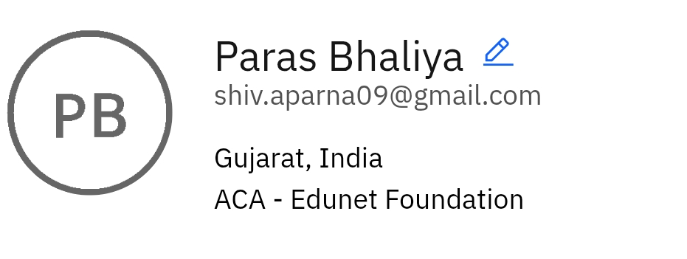
Skills build profile screen shot

Slide 22
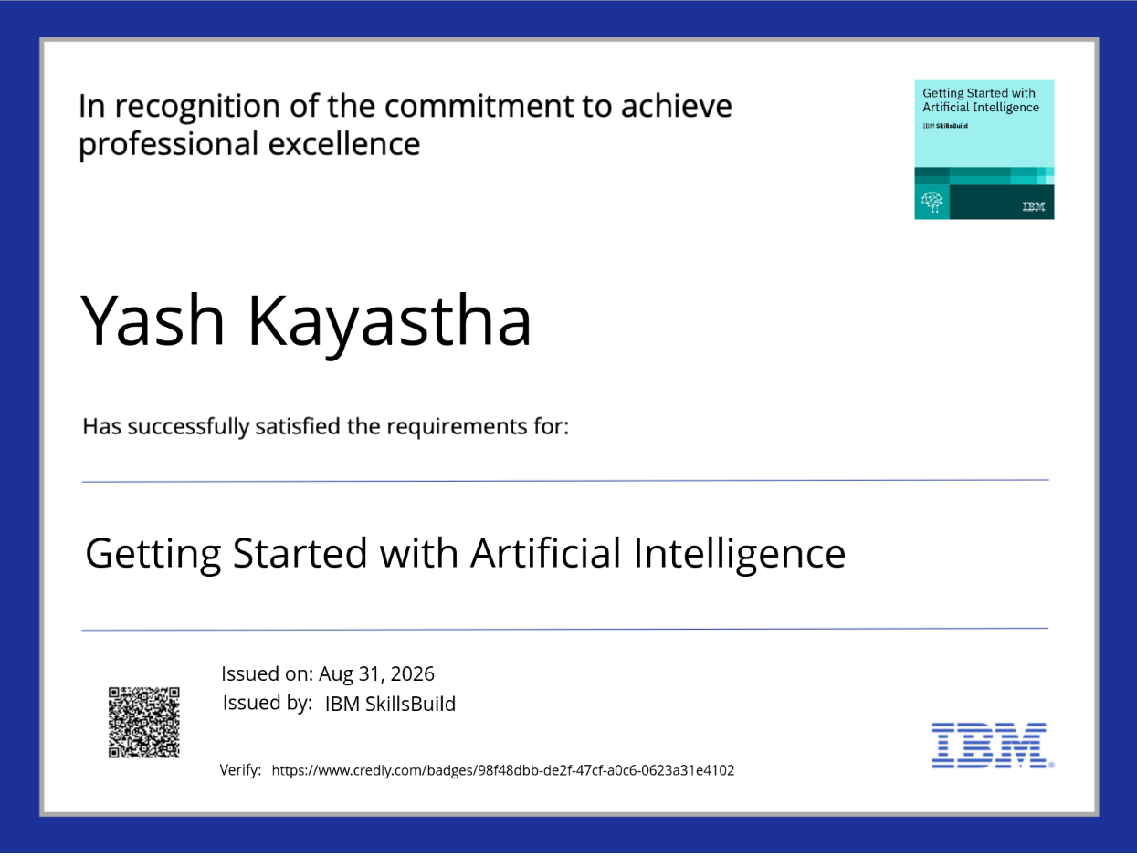
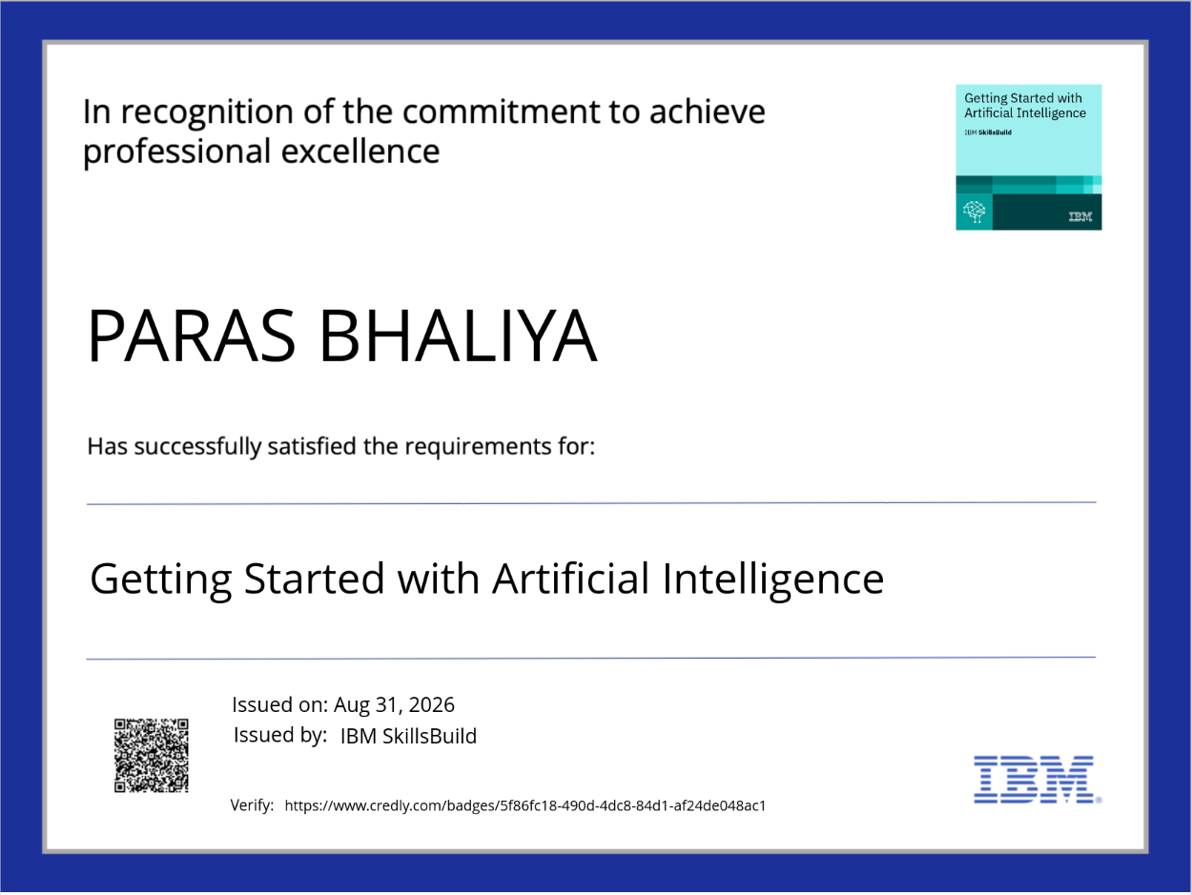
Certificate Earned :

Slide 23
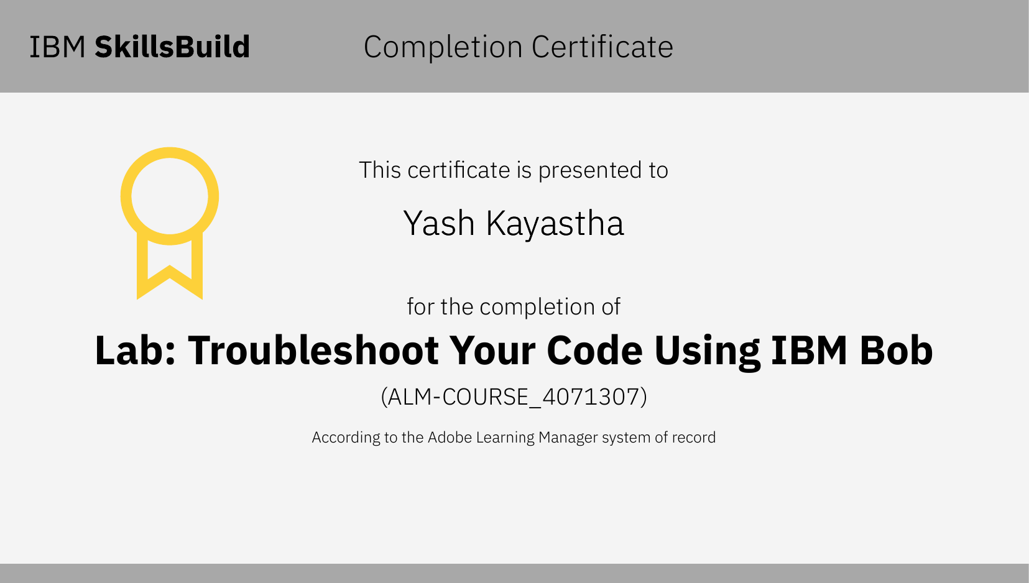
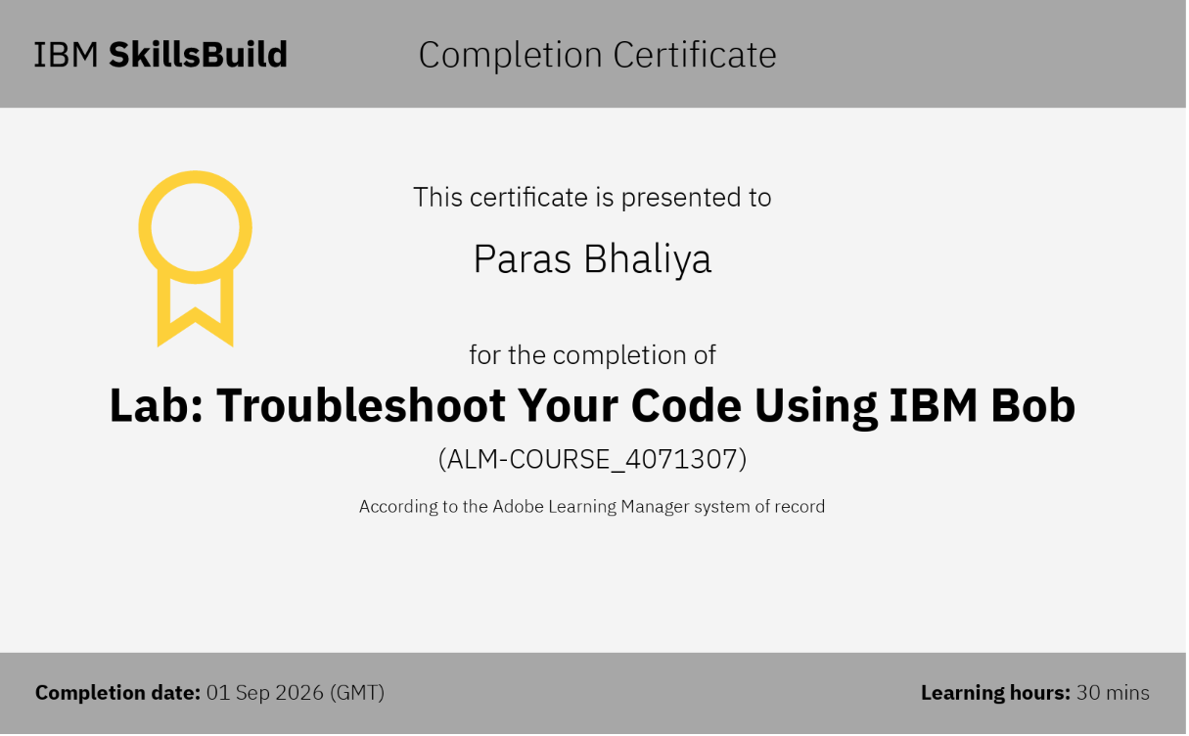
Certificate Earned :

Slide 24
Thank You!
Thank you for your time and interest.

